Slide 1
How Your Personal Data Can Help Catch Violent Criminals
W201 Group Project 2
2019 November 5th
Authors: John Lee // Alyssa Augsburger // Derek Topper
Audience: Politicians Considering Legislation
Notes:
John Slide:
How would you feel if the police caught a criminal using data gathered from your activities?
What if it was your DNA, used unknowingly, to catch your cousin?
Hello, we are John, Alyssa, and Derek and we will be presenting on How Your Personal Data Can Help Catch Violent Criminals. We are speaking to decision-making politicians to introduce this controversial topic of “Should we use data collected for other purposes, to solve crime?”

Slide 2
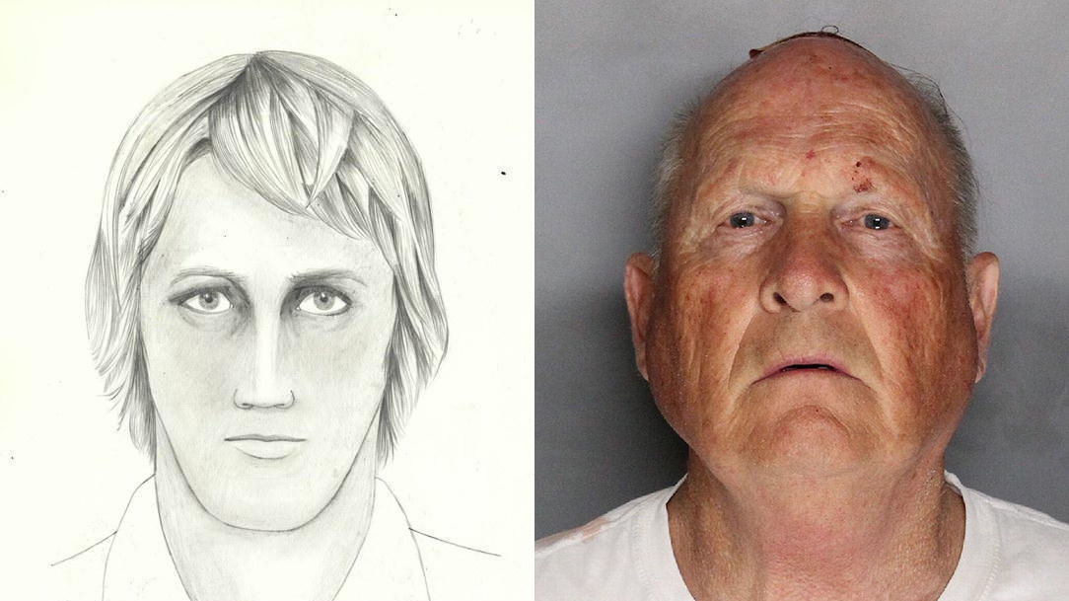
Crime Solving Before & After
Golden State Killer
Notes:
JOHN SLIDE
Let’s consider the case of the Golden State Killer.
In the 70’s for a span of 12 years, Joseph James DeAngelo committed 13+ murders, more than 50 rapes, and over 100 burglaries. As a former police officer, Joseph eluded capture and roamed free. When the crimes stopped, the trail went cold despite the authorities having collected DNA samples at crime scenes.
Whatever technology was used to capture criminals at the time was just not enough. However, in 2016, the use of an open-source genealogy website matched a distant relative back to the Golden State Killer. In 2018, this criminal was finally charged for his crimes.
Thanks to data gathered from the public, the police was able to solve a crime that otherwise wouldn’t have been solved. Therefore, using public data is good, right?

Slide 3
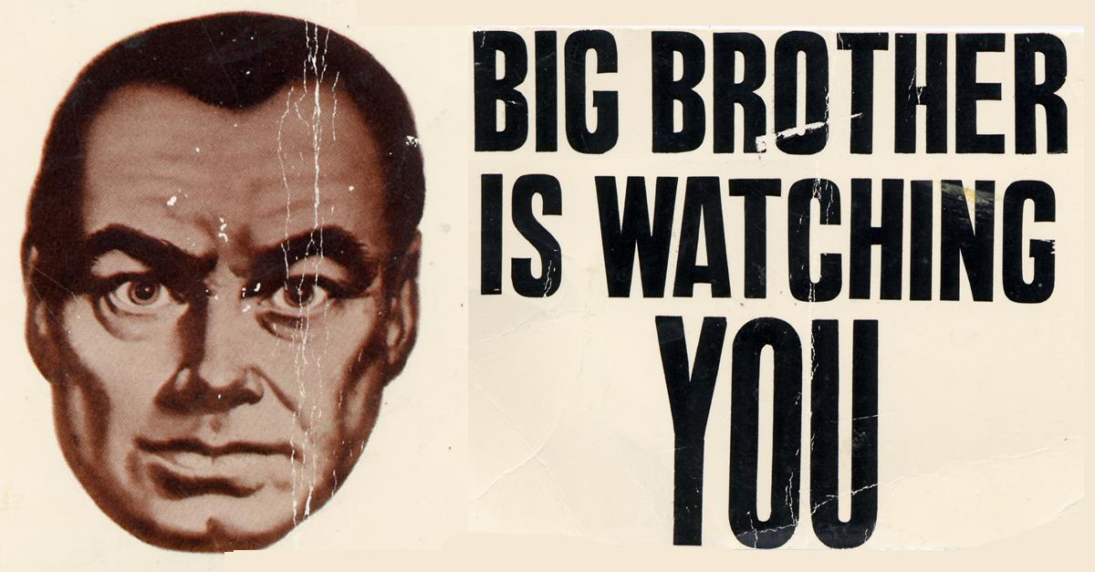
Use of Personal Data
Privacy
Bias
Cultural/Societal Effect
Notes:
JOHN SLIDE
What about side effects of personal data use?
Are you concerned with your data privacy or bias?
How would society change, if we just allow the authorities to use our data for any purposes?
These will be discussed further in this presentation.

Slide 4
The Pros
Notes:
JOHN SLIDE
Let’s begin with some benefits.

Slide 5

Crime Solving
Reduce time and increase efficiency
Victims and family would agree
Notes:
JOHN SLIDE
An obvious benefit of using data to solve crime is solving the crime! A 2015 article from NPR concluded that 1/3rd of murderers are unidentified mainly from lack of evidence. Hence, prosecutors would support using genealogy data because it helps to gather evidence more swiftly with less resources.
Since 2018, after the capture of the Golden State Killer, 50 rapes and homicides have been solved by using DNA databases. This shows that the data helps! Hence, the friends and families of victims would also support the usage of DNA data by law enforcement.

Slide 6

Prevention
Cautious Criminals
Notes:
JOHN SLIDE
Another benefit is crime prevention.
If people are aware of the uses of their personal data, they may change their behaviors. Likewise, if there are more ways to solve crime, potential criminals may be dissuaded from committing them.
Crime prevention would help save time for the authorities and increase neighborhood safety. Therefore, politicians, local residents, and police who all benefit would support this.

Slide 7
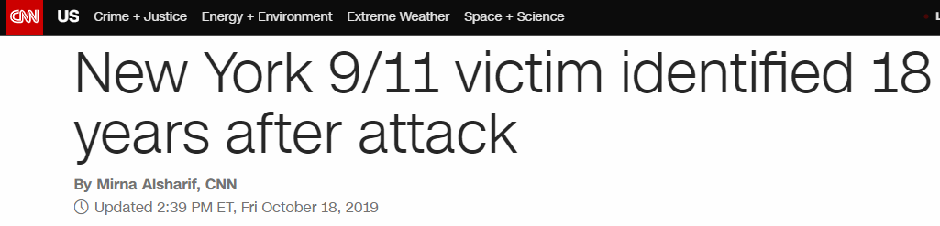
Other Outcomes
Exonerating the innocent
Identifying victims in disasters
Notes:
JOHN SLIDE
Family and friends of those who are jailed for wrongful conviction would also support using data to solve crime. Or even those related to unidentified victims of disasters.
This data can help exonerate the innocent or identify those who are missing.
Only a few weeks ago, improved DNA techniques helped identify another victim of the Sept. 11 attacks. There are still hundreds more to go.
Using data to help with all of these likely benefits are worth it. Wouldn’t you agree, Alyssa?

Slide 8
The Cons
Notes:
ALYSSA SLIDE
Let’s consider some negatives, John.

Slide 9

User Privacy
People don’t expect their data to be used for solving crimes
Don’t always have the option to opt in or out
Notes:
ALYSSA SLIDE
One of the biggest reasons why data collected for other purposes shouldn’t be used to solve crimes is user privacy.
Citizens worried about data privacy are concerned about how their data is used and who can access it.
For much of this data, such as DNA data and other personally identifiable information, users understand that this data is collected for purposes tangential to the main data collection purpose. Users don’t expect this data to be widely shared and analyzed in order to solve a crime.
Additionally, in many cases a user doesn’t even have the option to opt in or out of having their data collected.
There is an example where pacemaker data was used to convict someone of arson and insurance fraud, but someone with a pacemaker doesn’t have the option to opt in or out of having their data collected.
Another example is where someone’s relative may have opted in for their data to be collected and used on a website like 23andMe, but because DNA is genetic and shared between relatives, this data could be used to track down a distant relative of the person and that distant relative had never opted in.

Slide 10
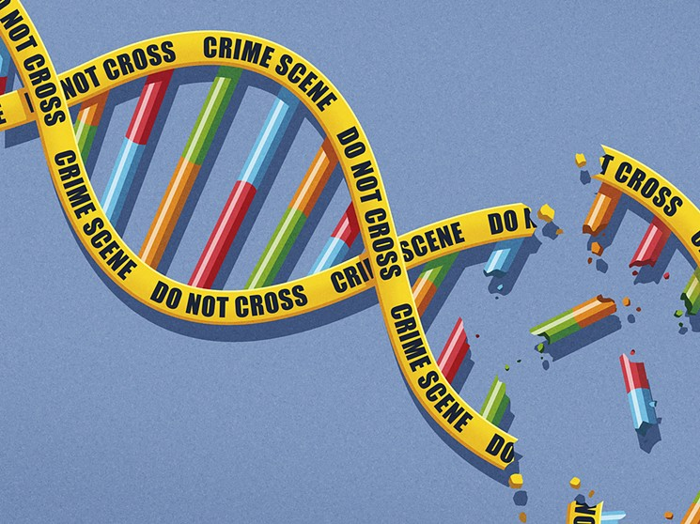
Data Accuracy and Bias
DNA evidence does not always mean a person is guilty
Forensic databases contain disproportionate amounts of data from certain racial groups
Notes:
ALYSSA SLIDE
Informed citizens, minorities, and those in the justice system have concerns about the reliability of DNA evidence.
Prosecutors and courts may over-interpret or misuse DNA data as a source of evidence.
It is a fallacy that DNA evidence implies guilt. It only shows that a person’s DNA was found at a given location, not that the person was necessarily present during or actually committed the crime.
Is DNA evidence a good enough standard of proof to convict someone of a crime?
There are also many concerns about known existing biases and discrimination.
Forensic databases disproportionately contain DNA from certain ethnic and geographic groups, so using biased databases will continue to perpetuate and exacerbate existing inequalities.
There are also concerns that expansive use of DNA data when solving crimes may lead to discrimination, particularly if police departments aggressively target certain groups by using racial or ethnic markers when looking for individual suspects.

Slide 11
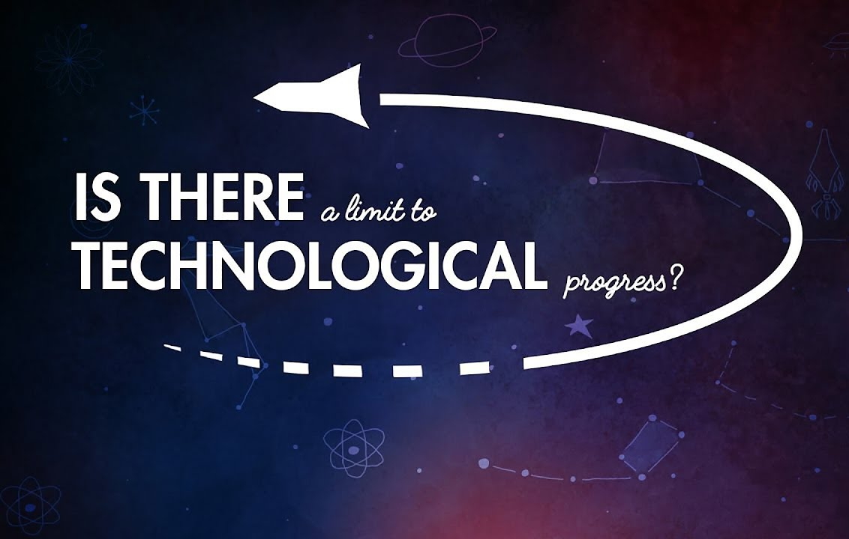
Prevent Progress
Companies may stop creating certain new technologies due to concerns of how the data will be used
People may forgo having certain health devices due to how the data they collect may be used against them
Notes:
ALYSSA SLIDE
Using data collected for other purposes to solve crimes could result in technology growth being slowed due to citizens’ concerns about what data new technology can collect and how it could potentially be used against them.
Companies are concerned with what data their devices collect and how it’s used. Knowing that the data their devices collect could potentially be used for crime solving purposes, could influence companies’ decisions about what new devices and features they should create.
In the previous example of using pacemaker data - could this example cause concerned citizens to forgo getting the same or similar type of life saving devices due to concerns of how their data could be used against them?

Slide 12
Moving Forward
Notes:
ALYSSA SLIDE
Considering both the pros and cons, let’s discuss what should be done moving forward.

Slide 13
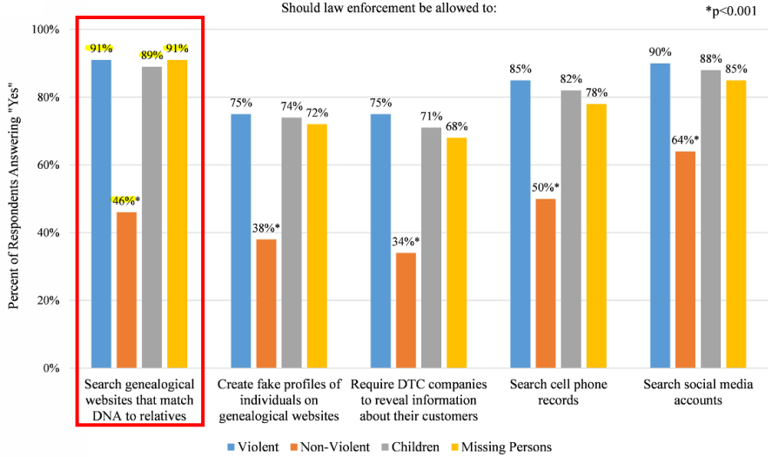
Solving Crime Wins
Available data collected for other purposes should be used to solve crimes
Solving crimes is such a large benefit and outweighs the downsides
Notes:
ALYSSA SLIDE
Although there are several valid concerns regarding the use of data collected for other purposes to solve crime, in the end if a crime can be solved using any available data, then that’s what should be done.
A recent survey from the Public Library of Science organization found that 90% of over 1500 people surveyed agreed that DNA from genealogical websites should be used to solve violent crimes and crimes involving children and missing persons.
The fact that crimes can be solved is such a large benefit that it strongly outweighs all the downsides.
In fact, DNA data is actually readily available and free for all, as it can be collected from a used coffee cup in a garbage can, so if DNA data is in a database, why shouldn’t it be used to solve crimes?
Additionally, utilizing and analyzing DNA data could potentially bring other undiscovered benefits down the road.
Graph Source: https://journals.plos.org/plosbiology/article?id=10.1371/journal.pbio.2006906

Slide 14

But There are Caveats with This
Could lead down a slippery slope where data is used in unexpected ways
China has been collecting DNA and facial imagery from its citizens
Notes:
DEREK SLIDE
The caveat with this is that this can very quickly lead down a slippery slope where data is used in all sorts of unexpected ways. In China, for example, the country has been using both collected facial recognition technology and collected DNA to track its citizens and control their behavior. In an extreme example, the country has gone so far as to scan its citizens faces in public restrooms and control the amount of toilet paper that they are given. China has also taken the DNA collected from members of an ethnic minority and added them to a public database, without the consent of the members of the group.

Slide 15

What Can We Do
Must secure the privacy and transparency of this data
Can allow users to opt in, rather than opt out, which makes them more aware of potential uses of their personal data
Notes:
DEREK SLIDE
While it may seem like a distant problem, these examples are key reasons why we must be vigilant about ensuring the transparency and privacy of data collected in this way. There are a few things that we can do to ensure that data is kept private from the potential harms of such a slippery slope.
A great answer is to create a regulatory body that maintains the privacy, safety and transparency of this data. Obviously this data is useful at a large scale and can help people find long lost family or become aware of diseases that they have certain risk factors for. However it is potentially frightening, that this data is in The hands of private corporations. Thus, it may be a good idea to have government oversight or some third party, which stores all of the data from these sources and works with both authorities and civil liberties groups to make sure that the data is used properly.
For one, we can regulate companies so that people have to opt in to be allowed to have their data used by the authorities for the purposes of identifying suspects.
If when using a DNA collection service, users are offered detailed choices about what they would like to opt in and opt out of, then we can ensure that their privacy is better maintained. Perhaps someone may want to allow long-lost family to locate them using their DNA, but may not want the authorities to be able to find them.

Slide 16
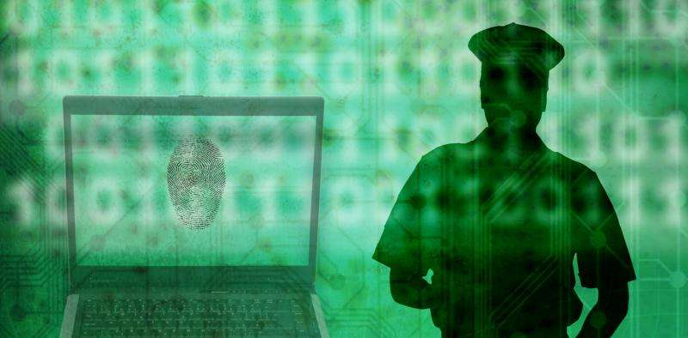
Ways To Fix This
Limit how this data is used by authorities
Remove personally identifiable information within the collected data
Create a regulatory body to maintain the privacy, and transparency of this data, relative to component users
Notes:
DEREK SLIDE
Another potential criteria for when to use this, would only allow police to use this for particular violent crimes. It is apparent that this type of data should be used for catching murderers and rapists or helping locate missing people, but it is much less clear if this data should be used for misdemeanor crimes, such as the possession of illegal drugs or public urination. While an overzealous police officer May want to use a service like 23 and me to catch an offender of a lesser crime, those who have implemented their DNA should ultimately have the choice as to if they want their DNA to be used in this way.
We should also ensure that this data is devoid of personally identifiable information, such as names or addresses, when presented to authorities, unless it appears that they are tied to a crime. We don’t want authorities to be able to monitor specific people using their DNA. This could cause potential biases as it may lead officers to target different individuals. This is key in preventing some of the specific problems that could be caused in the future by this.
The regulatory body would work to pass all of this, and other legislation as a way to help consumers of this DNA tool.

Slide 17

Ultimately,
There are huge benefits to this data, as it can be used to solve heinous crimes
However, we must be exceedingly careful that this data is used in very specific ways to avoid some of the problems that come with it
Notes:
DEREK SLIDE
There are huge benefits to this data, as it can be used to solve heinous crimes, such as the case of the Golden State Killer and in better understanding how crime can be solved.
However, we must be exceedingly careful that this data is used in very specific ways to avoid some of the problems that come with it. There are strong privacy and ethical concerns and there could be the potential for a large amount of bias.
Ultimately, the benefits are so large that we must find ways to mitigate the potential negative impacts, through ideas such as regulation and transparency. This will be necessary if we are to avoid heading down a dangerous path.

Slide 18
Thanks for Listening.
Questions?
Notes:
DEREK SLIDE

Slide 19
Bibliography
Berkman, Benjamin E, et al. “Is It Ethical to Use Genealogy Data to Solve Crimes?” Annals of Internal Medicine, U.S. National Library of Medicine, 4 Sept. 2018, www.ncbi.nlm.nih.gov/pmc/articles/PMC6123268/.
Guerrini, Christi J., et al. “Should Police Have Access to Genetic Genealogy Databases? Capturing the Golden State Killer and Other Criminals Using a Controversial New Forensic Technique.” PLOS Biology, Public Library of Science, journals.plos.org/plosbiology/article?id=10.1371%2Fjournal.pbio.2006906.
Jackson, Brian A. “Using Digital Data in Criminal Investigations.” RAND Corporation, 15 May 2017, www.rand.org/blog/2017/05/using-digital-data-in-criminal-investigations-where.html.
Jones, Natalie. “Bill Seeks to Prohibit Using DNA Databases to Solve Crime.” AP NEWS, Associated Press, 20 Feb. 2019, apnews.com/ddfa055f09e842bdbbbd38c2fba74a1a.
Kaste, Martin. “Open Cases: Why One-Third Of Murders In America Go Unresolved.” NPR, NPR, 30 Mar. 2015, www.npr.org/2015/03/30/395069137/open-cases-why-one-third-of-murders-in-america-go-unresolved.
Marzouka, George. “Is Using Genealogy Data to Solve Crimes Taking DNA Analysis a Step Too Far?” Medical Bag, 23 Feb. 2019, www.medicalbag.com/home/more/ethics/is-using-genealogy-data-to-solve-crimes-taking-dna-analysis-a-step-too-far/.
Mozur, Paul. “One Month, 500,000 Face Scans: How China Is Using A.I. to Profile a Minority.” The New York Times, The New York Times, 14 Apr. 2019, www.nytimes.com/2019/04/14/technology/china-surveillance-artificial-intelligence-racial-profiling.html.
Samuel, Sigal. “China Is Going to Outrageous Lengths to Surveil Its Own Citizens.” The Atlantic, Atlantic Media Company, 17 Aug. 2018, www.theatlantic.com/international/archive/2018/08/china-surveillance-technology-muslims/567443/.
Schuppe, Jon. “Police Were Cracking Cold Cases with a DNA Website. Then the Fine Print Changed.” NBCNews.com, NBCUniversal News Group, 29 Oct. 2019, www.nbcnews.com/news/us-news/police-were-cracking-cold-cases-dna-website-then-fine-print-n1070901.
Shammas, Brittany. “Hundreds of Broward Cases in Doubt Over DNA Testing Problems, Expert's Suspension for Sexism, Racism.” Miami New Times, 4, 13 Sept. 2018, www.miaminewtimes.com/news/hundreds-of-south-florida-cases-in-doubt-over-dna-testing-problems-9383687.
TED-Ed. Is There a Limit to Technological Progress? YouTube, YouTube, 19 Dec. 2016, www.youtube.com/watch?v=zVsHzS70krg.
Thompson, Suzannah. “Suppression and the Real Difference Between Opt-In and Opt-Out Subscription Management.” ClickDimensions Blog, 29 Nov. 2018, blog.clickdimensions.com/suppression-real-difference-opt-opt-subscription-management/.

